Slide 1
Post Graduate Program
In DevOps

Slide 2
Code Quality Improvement Using Jenkins

Slide 3

By the end of this lesson, you will be able to:
Explain the significance of code quality and its metrics
Implement different code quality analysis tools
Generate XML reports on code complexity
Implement SonarQube with Jenkins

Slide 4
Code Quality and Jenkins

Slide 5
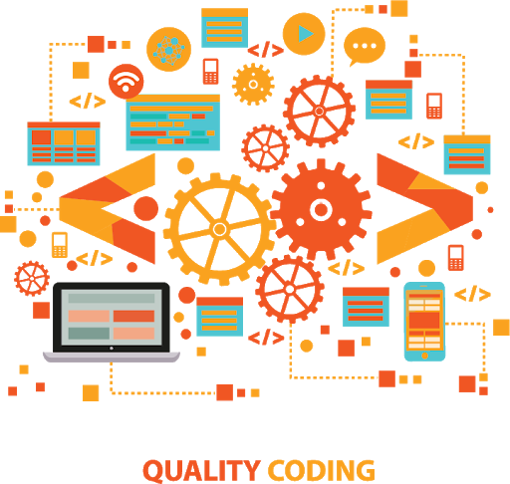
Introduction
Coding standards are rules that define the coding styles and conventions that are common across an organization for better understanding of the product development.
Coding standards include both aesthetic aspects such as formatting, and bad practice such as missing brackets after a condition in Java.
A consistent coding style makes it easy to work on the code written by other developers by making it clean and readable.
Notes:
Trainer Notes:
Explain all the points to the learner

Slide 6
Code Quality Metrics
Code quality metrics include different aspects of code, such as coding standards and best practices to code coverage, along with compiler warnings to TODO comments.
Poor coding practices
Number of lines of code
Code Quality Metrics
Potential bugs
Average code complexity
Notes:
Trainer Notes:
Explain all the points to the learner

Slide 7




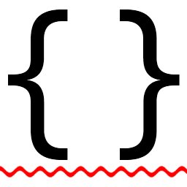
Code Quality Tools
CheckStyle
SonarQube
FindBugs
Cobertura
StyleCop
Notes:
Trainer Notes:
Explain all the points to the learner

Slide 8
Code Quality in Build Process
Before working with Jenkins, it is important to understand code quality metrics as an isolated entity with one framework or server and make it part of a broader process.
The first level of code quality integration is the IDE.
Modern IDEs support most of the code quality tools, such as Checkstyle, PMD, and FindBugs have plugins for Eclipse, NetBeans, and IntelliJ.
It is a fast and reliable way to provide feedback to individual developers.
The second level is your build server.
In addition to a single unit and integration test build jobs, dedicated code quality build is a useful entity, which runs after the build and test.
It aims to produce project-wide code quality metrics.
Notes:
Trainer Notes:
Explain all the points to the learner

Slide 9

Code Quality in Build Process
As code coverage analysis and other analysis tools can be quite slow to run, it is recommended to run code quality analysis job separately.
Code quality reporting is a relatively passive process.
One has to search for the information on the build server, rather than simply reporting on code quality.
It is important to set up a dedicated code quality build that runs after the build and test, and configure the build to fail.
Jenkins provides the facility to do code quality reporting or one can also do it in build script.
The advantage of configuring code quality outside the build script is that one can change code quality build failing criteria more easily without hindering the source code.
Notes:
Trainer Notes:
Explain all the points to the learner

Slide 10
Checkstyle
Checkstyle is a static analysis tool for Java. It was designed to define a set of coding standards, however, now it also checks for poor coding practices, and complex and duplicated code.
It is a flexible tool.
It can be used in any Java-based code quality analysis strategy.
It supports a number of rules, such as naming conventions, Java file comments, class and method size, annotations, code complexity metrics, and bad coding practices.
Duplicated code is a critical code quality issue as it is harder to maintain and debug.
Though Checkstyle provides support for detecting a duplicated code, one can use tools, such as CPD for better results in detection of duplicated code.
Notes:
Trainer Notes:
Explain all the points to the learner

Slide 11
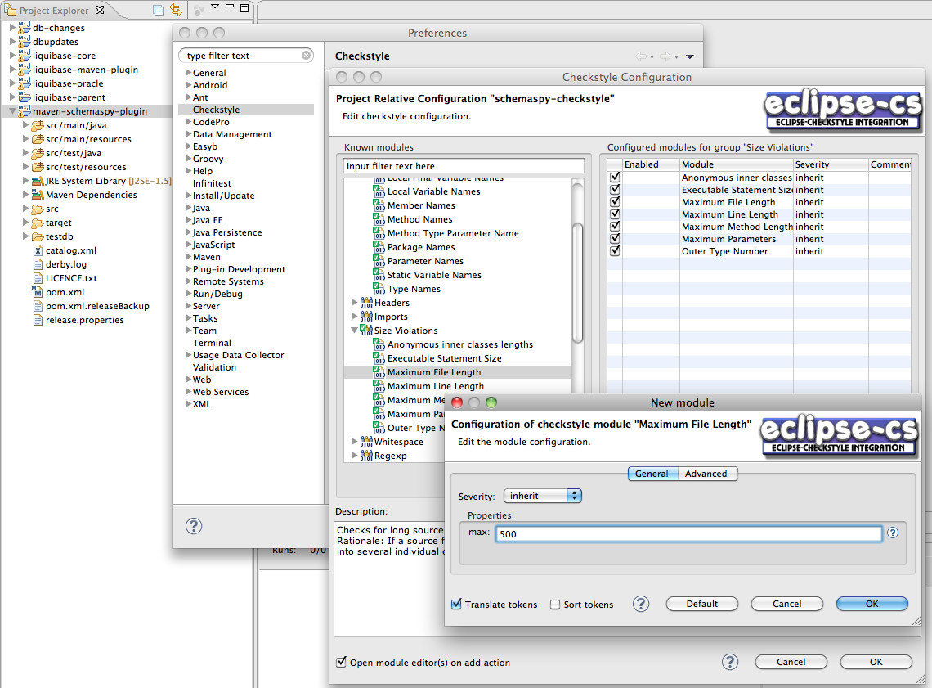
Checkstyle Eclipse Plugin
Notes:
Trainer Notes:
Explain all the points to the learner

Slide 12
Checkstyle with Maven
To integrate Checkstyle with Maven, enter the codes given below in pom.xml:
Maven2:
<reporting>
<plugins>
<plugin>
<groupId>org.apache.maven.plugins</groupId>
<artifactId>maven-checkstyle-plugin</artifactId>
<version>2.4</version>
<configuration>
<configLocation> src/main/config/company-checks.xml </configLocation>
</configuration>
</plugin>
</plugins>
</reporting>
For a Maven 3 project, you need to add the plugin to the <reportPlugins> element of the <configuration> section of the maven-site-plugin.
Running mvn checkstyle:checkstyle or mvn site will analyse your source code and generate XML reports
Notes:
Trainer Notes:
Explain all the points to the learner

Slide 13
PMD
PMD is another popular static analysis tool, which focuses on potential coding problems such as unused code, code size and complexity, and coding practices.
PMD contains rules like Empty If Statement, Broken Null Check, Avoid Deeply Nested If Statements, and Logger Is Not Static Final.
PMD does have some more technical rules, and more specialized ones such as rules related to JSF and Android, when compared to Checkstyle.
PMD also comes with CPD, which is an open source detector of duplicated code.
Notes:
Trainer Notes:
Explain all the points to the learner

Slide 14
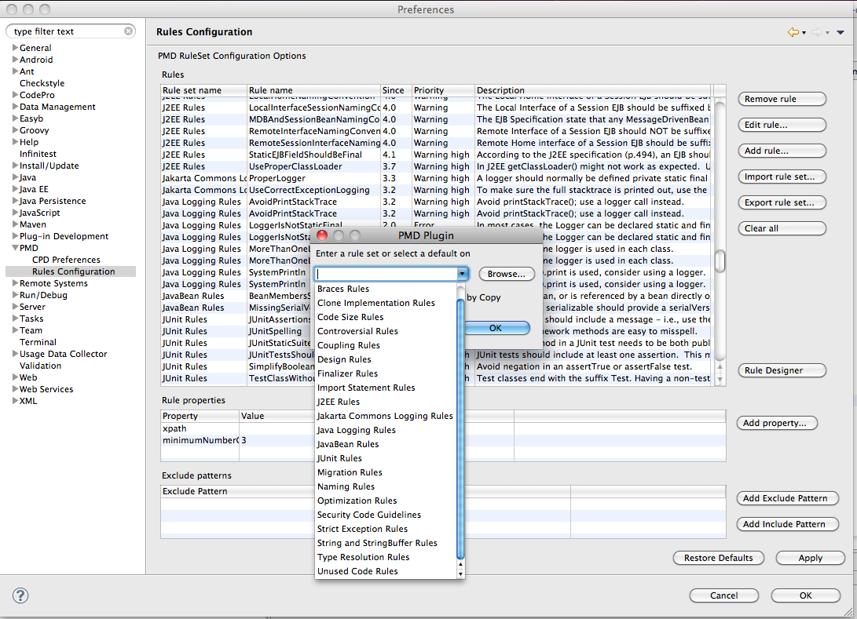
PMD Rules in Eclipse
Notes:
Trainer Notes:
Explain all the points to the learner

Slide 15

PMD with Ant
PMD comes with an Ant task that can be used to generate PMD and CPD reports.
First step is to define the tasks, as shown below:
<path id="pmd.classpath">
<pathelement location="${build}"/>
<fileset dir="lib/pmd">
<include name="*.jar"/>
</fileset>
</path>
<taskdef name="pmd" classname="net.sourceforge.pmd.ant.PMDTask“ classpathref="pmd.classpath"/>
<taskdef name="cpd" classname="net.sourceforge.pmd.cpd.CPDTask“ classpathref="pmd.classpath"/>
Notes:
Trainer Notes:
Explain all the points to the learner

Slide 16
PMD with Ant
PMD comes with an Ant task that can be used to generate PMD and CPD reports.
Next, generate the PMD XML report by calling the PMD task, as shown below:
<target name="pmd">
<taskdef name="pmd" classname="net.sourceforge.pmd.ant.PMDTask“ classpathref="pmd.classpath"/>
<pmd rulesetfiles="basic" shortFilenames="true">
<formatter type="xml" toFile="target/pmd.xml" />
<fileset dir="src/main/java" includes="**/*.java"/>
</pmd>
</target>
To generate the CPD XML report:
<target name="cpd">
<cpd minimumTokenCount="100" format="xml" outputFile="/target/cpd.xml">
<fileset dir="src/main/java" includes="**/*.java"/>
</cpd>
</target>
Notes:
Trainer Notes:
Explain all the points to the learner

Slide 17
PMD with Maven
To configure Maven 2 for PMD and CPD reports with an exported XML ruleset, follow the code snippet as shown here:
<reporting>
<plugins>
<plugin>
<groupId>org.apache.maven.plugins</groupId>
<artifactId>maven-pmd-plugin</artifactId>
<version>2.5</version>
<configuration>
<!-- PMD options -->
<targetJdk>1.6</targetJdk>
<aggregate>true</aggregate>
<format>xml</format>
<rulesets>
<ruleset>/pmd-rules.xml</ruleset>
</rulesets>
<!-- CPD options -->
<minimumTokens>20</minimumTokens>
<ignoreIdentifiers>true</ignoreIdentifiers>
</configuration>
</plugin>
</plugins>
</reporting>
Notes:
Trainer Notes:
Explain all the points to the learner

Slide 18
PMD with Maven
In Maven 3, place the plugin definition in the <maven-siteplugin> configuration section. Run either mvn site or mvn pmd:pmd pmd:cpd to generate the PMD and CPD reports.
<project>
<build>
<plugins>
<plugin>
<groupId>org.apache.maven.plugins</groupId>
<artifactId>maven-site-plugin</artifactId>
<version>3.0-beta-2</version>
<configuration>
<reportPlugins>
<plugin>
<groupId>org.apache.maven.plugins</groupId>
<artifactId>maven-pmd-plugin</artifactId>
<version>2.5</version>
<configuration>
<!-- PMD options -->
<targetJdk>1.6</targetJdk>
<aggregate>true</aggregate>
<format>xml</format>
<rulesets>
<ruleset>/pmd-rules.xml</ruleset>
</rulesets>
<!-- CPD options -->
<minimumTokens>50</minimumTokens>
<ignoreIdentifiers>true</ignoreIdentifiers>
</configuration>
</plugin>
</reportPlugins>
</configuration>
<dependencies>
<dependency>
<groupId>com.wakaleo.code-quality</groupId>
<artifactId>pmd-rules</artifactId>
<version>1.0.1</version>
</dependency>
</dependencies>
</plugin>
</plugins>
</build>
</project>
Notes:
Trainer Notes:
Explain all the points to the learner

Slide 19
FindBugs
FindBugs is a code quality analysis tool that checks application byte code for potential bugs, performance problems, and poor coding habits.
FindBugs can detect critical issues such as null pointer exceptions, and infinite loops.
Although FindBugs detects less number of issues, the ones detected are critical.
FindBugs is less configurable than the other tools.
In FindBugs, one can’t configure a shared XML file between Maven builds and the IDE.
Notes:
Trainer Notes:
Explain all the points to the learner

Slide 20
FindBugs with Ant
FindBugs comes bundled with an Ant task. Define the FindBugs task in Ant as shown below.
FindBugs needs to point to the FindBugs home directory, where the binary distribution has been unzipped.
To make the build more portable, store the FindBugs installation in the project directory structure, in the tools/findbugs directory:
<property name="findbugs.home" value="tools/findbugs" />
<taskdef name="findbugs" classname="edu.umd.cs.findbugs.anttask.FindBugsTask" >
<classpath>
<fileset dir="${findbugs.home}/lib" includes="**/*.jar"/>
</classpath>
</taskdef>
To run FindBugs, set up a target as shown below:
Note that it runs against the application byte-code, and not source code, so you need to compile your source code first:
<target name="findbugs" depends="compile">
<findbugs home="${findbugs.home}" output="xml" outputFile="target/findbugs.xml">
<class location="${classes.dir}" />
<auxClasspath refId="dependency.classpath" />
<sourcePath path="src/main/java" />
</findbugs>
</target>
Notes:
Trainer Notes:
Explain all the points to the learner

Slide 21
FindBugs with Maven
For Maven 2, keep a local copy of the FindBugs installation. Configure FindBugs in the reporting section as shown in the pom.xml file:
<reporting>
<plugins>
<plugin>
<groupId>org.codehaus.mojo</groupId>
<artifactId>findbugs-maven-plugin</artifactId>
<version>2.3.1</version>
<configuration>
<effort>Max</effort>
<xmlOutput>true</xmlOutput>
</configuration>
</plugin>
</plugins>
</reporting>
Notes:
Trainer Notes:
Explain all the points to the learner

Slide 22
FindBugs with Maven
For Maven 3:
<plugins>
<plugin>
<groupId>org.apache.maven.plugins</groupId>
<artifactId>maven-site-plugin</artifactId>
<version>3.0-beta-2</version>
<configuration>
<reportPlugins>
<plugin>
<groupId>org.codehaus.mojo</groupId>
<artifactId>findbugs-maven-plugin</artifactId>
<version>2.3.1</version>
<configuration>
<effort>Max</effort>
<xmlOutput>true</xmlOutput>
</configuration>
</plugin>
</reportPlugins>
</configuration>
</plugin>
</plugins>
Notes:
Trainer Notes:
Explain all the points to the learner

Slide 23
Reporting on Code Quality
Jenkins provides a useful plugin for code quality called the Violations plugin. Although it will not analyze your project source code, it does a great job reporting on the code quality metrics generated for individual builds and trends over time.
Violation plugin caters to reports on code quality metrics received from the static analysis tools, including:
For Java:
Checkstyle, CPD, PMD, FindBugs, and jcreport
For Groovy:
codenarc
For JavaScript:
jslint
For .Net:
gendarme and stylecop
Notes:
Trainer Notes:
Explain all the points to the learner

Slide 24
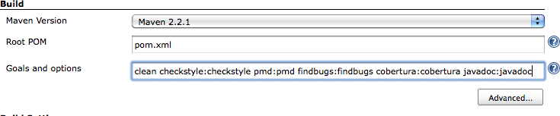
Reporting on Code Quality
The Violations plugin does not generate the code quality metrics data. It is added in the build configuration as shown below:
In the above example, plugins are called directly, which results in faster builds.
After the set up, configure the violations plugin to generate reports and, if required, trigger notifications, based on the report results.
Go to the Post build Actions and check the Report Violations checkbox.
Notes:
Trainer Notes:
Explain all the points to the learner

Slide 25
Internals of Jenkins Jobs

Slide 26
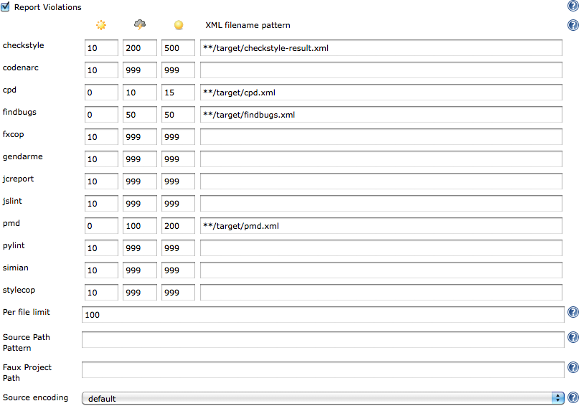
Working with Freestyle Jobs
Freestyle build jobs provide maximum configuration flexibility and are the best option for non-Java projects.
While setting up violations plugin with a Freestyle build job, specify the locations to all XML reports generated by the static analysis tools.
Use a wildcard expression to identify the reports you want. For example: **/target/checkstyle.xml.
Notes:
Trainer Notes:
Explain all the points to the learner

Slide 27
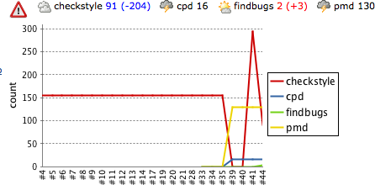
Working with Freestyle Jobs
The Violations plugin generates a graph which tracks the total number of issues over time.
The graph illustrates different colored lines for each violation tracked.
It also displays a summary of the latest results.
Notes:
Trainer Notes:
Explain all the points to the learner

Slide 28
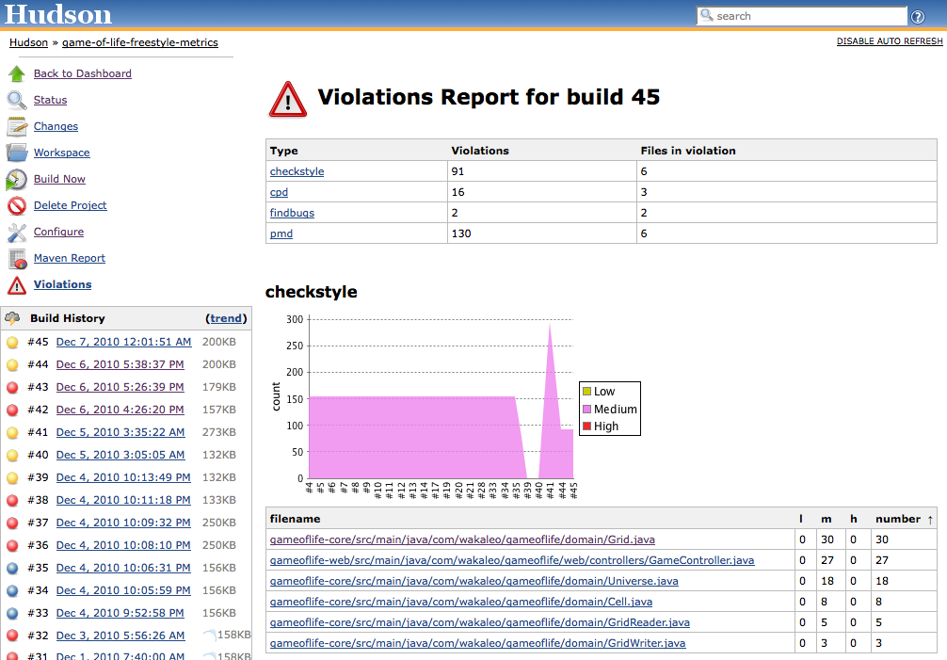
Working with Freestyle Jobs
By clicking on the report, one can expand and analyze the details of every violation, as shown below:
Notes:
Trainer Notes:
Explain all the points to the learner

Slide 29
Code Quality and Jenkins

Slide 30
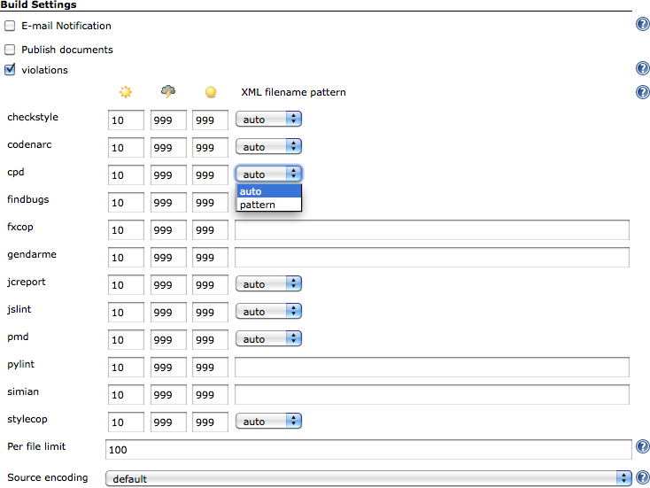
Working with Maven Build Jobs
Maven build jobs in Jenkins use the Maven conventions and data present in the project’s pom.xml file to make configuration easier and execution faster.
In violations plugin with a Maven build job, Jenkins uses pom.xml file data to reduce configuration code for the plugin.
Jenkins gets the location of XML reports for many of the static analysis tools based on the Maven conventions and plugin configurations in pom.xml
To override project conventions, choose the pattern option in the XML filename pattern drop-down list and enter a path similar to the freestyle build jobs.
Notes:
Trainer Notes:
Explain all the points to the learner

Slide 31
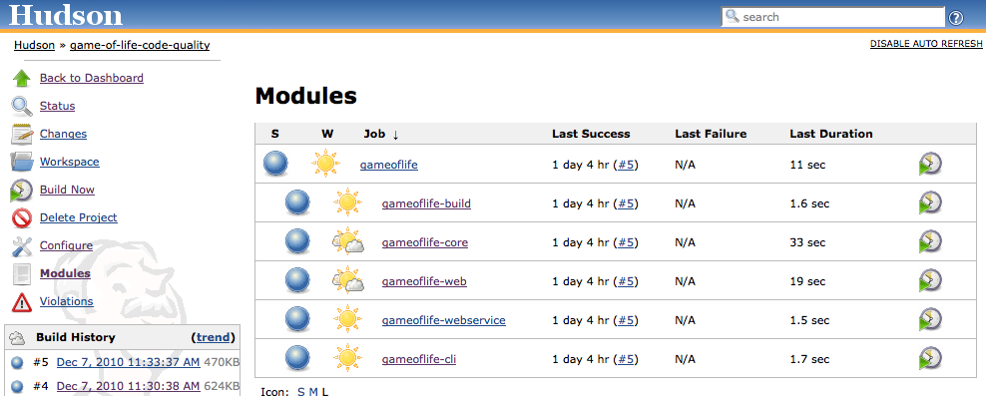
Working with Maven Build Jobs
The Violations plugin is primarily used in multi-module Maven projects. Below screenshot is an example of multi-module project:
Notes:
Trainer Notes:
Explain all the points to the learner

Slide 32
Working with Maven Build Jobs
By default, the violations plugin will display an aggregated view of the code quality metrics as shown below. Click on the violations graph to view the detailed reports for each module.
For the efficient working of plugin, activate the violations plugin for each module in addition to the main project.
Notes:
Trainer Notes:
Explain all the points to the learner

Slide 33
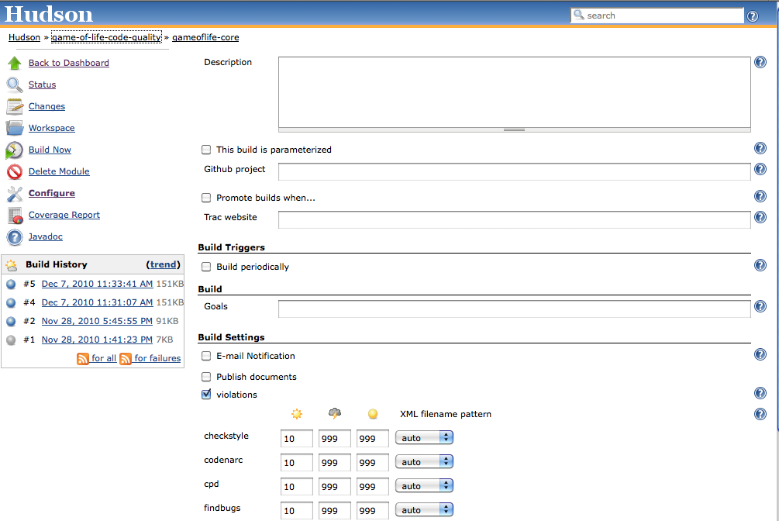
Exploring Maven Build Fields
Click on the module you want to configure in the Modules screen, and click on the Configure menu.
Activate the violations option and provide the thresholds if required.
Click on the violations aggregate graph on the project build job home page to list the individual violations graphs for each module by Jenkins
Notes:
Trainer Notes:
Explain all the points to the learner

Slide 34
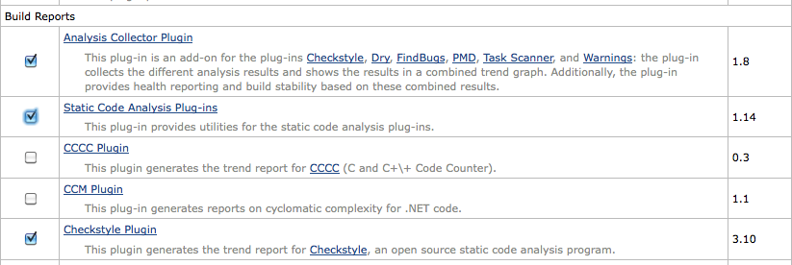
Using Checkstyle, PMD, and FindBigs Reports
In addition to the violations plugin, Jenkins plugins also produce trend graphs and detailed reports for each tool. Analysis Collector Plugin is similar to violations plugin that displays the combined results in a graph.
Once installed, set up the report in the project configuration by checking the Publish Checkstyle analysis results checkbox.
In a freestyle build, specify a path to find the checkstyle XML reports.
In a Maven 2 build, Jenkins will automatically analyze and find the location from the project configuration.
Notes:
Trainer Notes:
Explain all the points to the learner

Slide 35
FindBugs Integration with Jenkins
Problem Statement: You are given a project to integrate FindBugs with Jenkins.
Steps to perform:
Login to Jenkins
Create a Maven job
Install FindBugs plugin
Add FindBugs dependencies in Maven project
Notes:
Trainer Notes:
Explain the objective

Slide 36
Reporting on Code Complexity

Slide 37
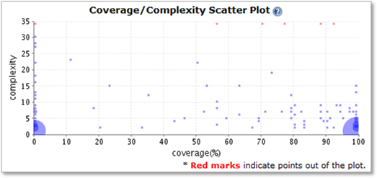
Reporting on Code Complexity
Code complexity can be measured in different ways and one of them is Cyclomatic Complexity. This involves measuring the number of different paths through a method.
The Coverage/Complexity Scatter Plot plugin is designed to display code complexity report in Jenkins.
Complex or untested methods will appear high on the graph, where as the well-written and tested methods will appear lower down.
Notes:
Trainer Notes:
Explain all the points to the learner

Slide 38
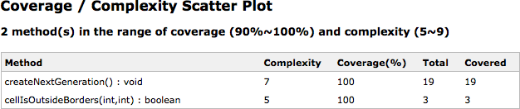
Reporting on Code Complexity
The Coverage/Complexity Scatter Plot also allows to expand and get more detailed information of the methods. You can click on any point in the graph to display the corresponding methods with their test coverage and complexity.
Since this plugin requires Clover, the build would have already generated a Clover XML coverage report. Support for Cobertura and other tools is yet to be released.
Notes:
Trainer Notes:
Explain all the points to the learner

Slide 39
Coverage/Complexity Scatter Plot with Jenkins
Problem Statement: You are given a project to integrate Coverage Complexity Scatter Plot plugin with Jenkins.
Steps to perform:
Login to Jenkins
Install and set up Clover
Install Coverage Complexity Scatter Plot plugin
Notes:
Trainer Notes:
Explain the objective

Slide 40
Reporting on Open Tasks

Slide 41
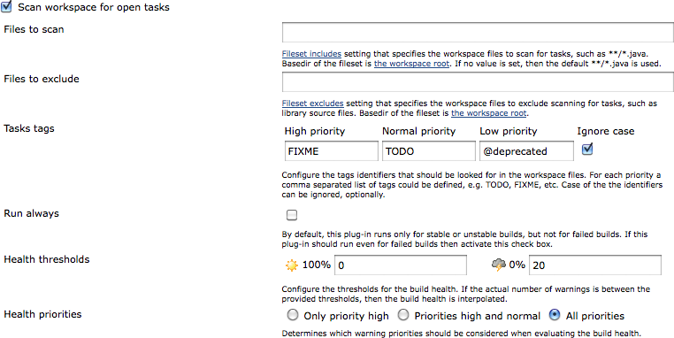
Reporting on Open Tasks
The Jenkins Task Scanner plugin keeps the track of different tags in the source code and represents a build with a bad weather icon on the dashboard if the number of open tasks are more.
To set up, install both the Static Analysis Utilities plugin and the Task Scanner plugin.
Activate the plugin in the project by checking the Scan workspace for open tasks checkbox in the Build Settings section of the project job configuration.
Enter the tags for tracking with different priorities.
By default, the plugin will scan all the Java source code in the project that can be limited by entering the files to the scan field.
Notes:
Trainer Notes:
Explain all the points to the learner

Slide 42
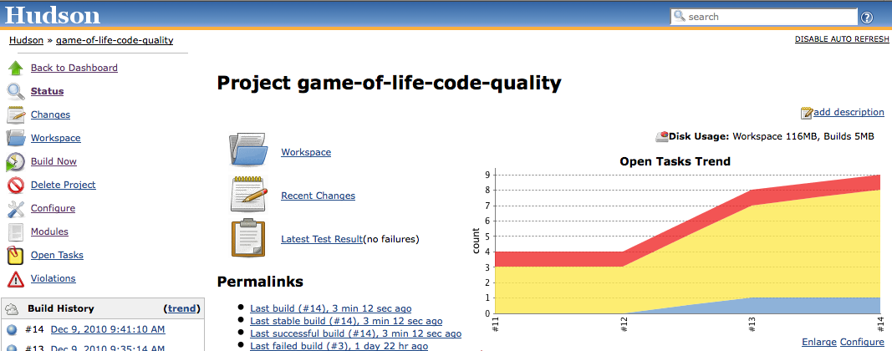
Reporting on Open Tasks
The plugin generates a graph that shows tag trends by priority. Click on the Open Tasks Report to display the breakdown of tasks by Maven module, package or file, or open tasks. A sample graph is shown below:
Notes:
Trainer Notes:
Explain all the points to the learner

Slide 43
SonarQube

Slide 44

Introduction
Sonar is a tool that centralizes a range of code quality metrics into a single website. It uses Maven plugins to analyze Maven projects and generate a set of code quality metrics reports.
SonarQube generates reports on code coverage, rule compliance and documentation, complexity, maintainability, and technical debt.
It can be extend to add support for other languages.
The rules configured centrally on the Sonar website and the Maven project don’t require any particular configuration.
This makes Sonar highly suitable for working on Maven projects.
Notes:
Trainer Notes:
Explain all the points to the learner

Slide 45
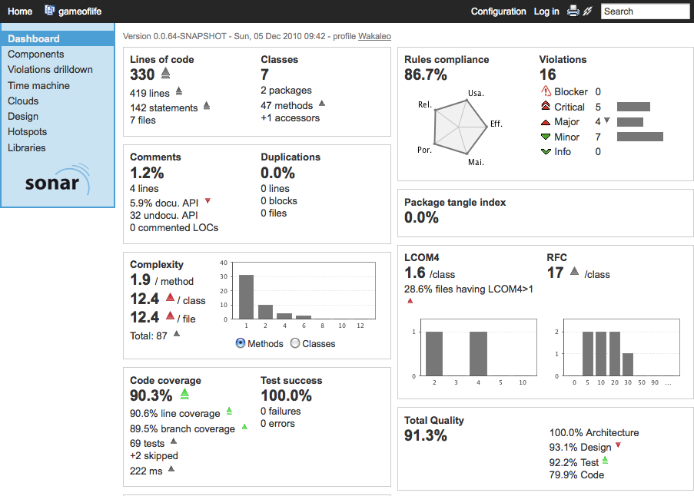
Sonar Report
The screenshot of the Sonar server that runs separately along with analyzing and displaying results is given below:
Notes:
Trainer Notes:
Explain all the points to the learner

Slide 46
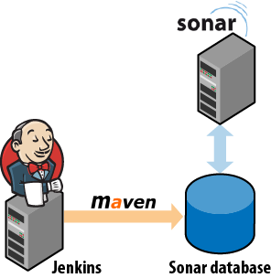
SonarQube with Jenkins
The Jenkins Sonar Plugin provides the facility to define Sonar instances for all the projects and activates Sonar in particular builds.
One can run Sonar server on a separate machine or on the same Jenkins instance.
Jenkins instance must have JDBC access to the Sonar database. This is the only constraint.
Sonar injects code quality metrics directly into the database.
Sonar also works with Ant for non-maven users.
Notes:
Trainer Notes:
Explain all the points to the learner

Slide 47

SonarQube with Jenkins
Once installed from the plugin manager, configure the Jenkins Sonar plugin in the Configure System screen, under the Sonar section.
Define the Sonar instances. By default, it assumes that Sonar is running locally with the default embedded database.
For a production environment, run Sonar on a real database such as MySQL.
Configure the JDBC connection to the production Sonar database in Jenkins by clicking on the Advanced button in the configuration settings.
Notes:
Trainer Notes:
Explain all the points to the learner

Slide 48
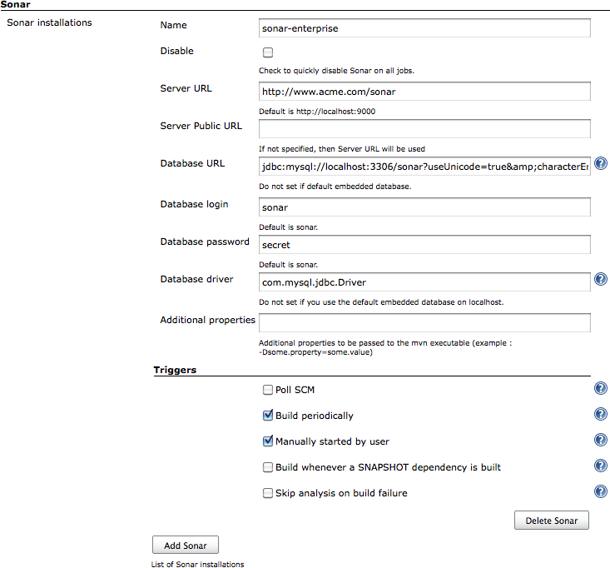
Sonar Configuration
Notes:
Trainer Notes:
Explain all the points to the learner

Slide 49
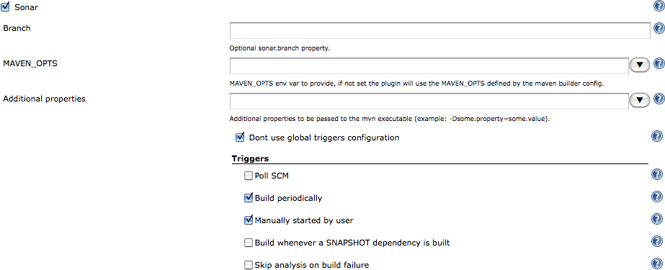
Sonar Configuration
Configure Sonar to run with one of the long-running Jenkins build jobs.
It is not recommended to run the Sonar build more than once in a day.
The default configuration executes a Sonar build in a Sonar-enabled build job when the job is triggered by a periodically scheduled build or by a manual build.
To activate Sonar in build job with the system-wide configuration, check the Sonar option in the Post-Build Actions.
Sonar will run every time the build is started by one of the triggers.
Notes:
Trainer Notes:
Explain all the points to the learner

Slide 50
SonarQube Integration with Jenkins
Problem Statement: You are given a project to integrate SonarQube with Jenkins.
Steps to Perform:
Install SonarQube on your local system.
Install and configure SonarQube plugin in Jenkins
Notes:
Trainer Notes:
Explain the objective

Slide 51
Coding standards are rules that define the coding styles and conventions that are common across an organization.
It is important to set up a dedicated code quality build that runs after the build and test, and configure the build to fail.
Checkstyle provides support for the detection of duplicated code, one shall use tools, such as CPD for a better results in detection of duplicated code.
Violation plugin caters to reports on code quality metrics received from the static analysis tools.
Freestyle build jobs provide maximum configuration flexibility, and are the best option for non-Java projects.

Slide 53
Which of the following is NOT a code quality metric?
1
Number of lines
Code complexity
Project type
None of the above

Slide 54
Which of the following is NOT a code quality metric?
1
Number of lines
Code complexity
Project type
None of the above
C
Code quality operations runs regardless of the type of the project.

Slide 55
What is the first step of code quality integration?
2
IDE
Jenkins
Both
None of the above

Slide 56
What is the first step of code quality integration?
2
IDE
Jenkins
Both
None of the above
A
First integration of a code quality tool in the IDE.

Slide 57
Which command is used to run checkstyle in Maven 3?
3
mvn checkstyle:checkstyle
mvn site
Both
None of the above

Slide 58
Which command is used to run checkstyle in Maven 3?
3
mvn checkstyle:checkstyle
mvn site
Both
None of the above
C
Mvn checkstyle:checkstyle and mvn site, both can be used to run checkstyle.

Slide 59
Which of the following is a limitation of FindBugs?
4
It can detect critical issues such as null pointer exceptions and infinite loops.
It detects less number of issues, but those issues will be important.
It is less configurable than the other tools.
It can’t configure a shared XML file between Maven builds and the IDE.

Slide 60
Which of the following is a limitation of FindBugs?
4
It can detect critical issues such as null pointer exceptions and infinite loops.
It detects less number of issues, but those issues will be important.
It is less configurable than the other tools.
It can’t configure a shared XML file between Maven builds and the IDE.
D
It can’t configure a shared XML file between Maven builds and the IDE.

Slide 61
What is an important thing to remember when working with FindBugs with Ant?
5
Store the FindBugs installation in the project directory structure
Compile the project first before exposing it to FindBugs
Both
None of the above

Slide 62
What is an important thing to remember when working with FindBugs with Ant?
5
Store the FindBugs installation in the project directory structure
Compile the project first before exposing it to FindBugs
Both
None of the above
B
FindBugs runs against the application byte-code, and not source code, so you need to compile your source code first.

Slide 63
Static Code Analysis
Problem Statement:
You’re a DevOps engineer at ABC software, a service-based software development company. The company is trying to implement a new coding standard to help avoid code refactoring. As a pilot, the company wants to perform daily static code analysis on its new project which is a retail management system for their new clients FreshMart. You’re tasked with setting up a Jenkins build job that polls the SCM for the FreshMart project nightly and performs static code analysis using SonarQube and publishes the result. The retail management system will be a Maven project and the developers will be committing their codes to a git repository daily before they clock out.
Requirements:
The pipeline should be built with the SonarQube plugin
The pipeline should poll the SCM every night and perform the analysis

